Slide 1


Powered by

Slide 2
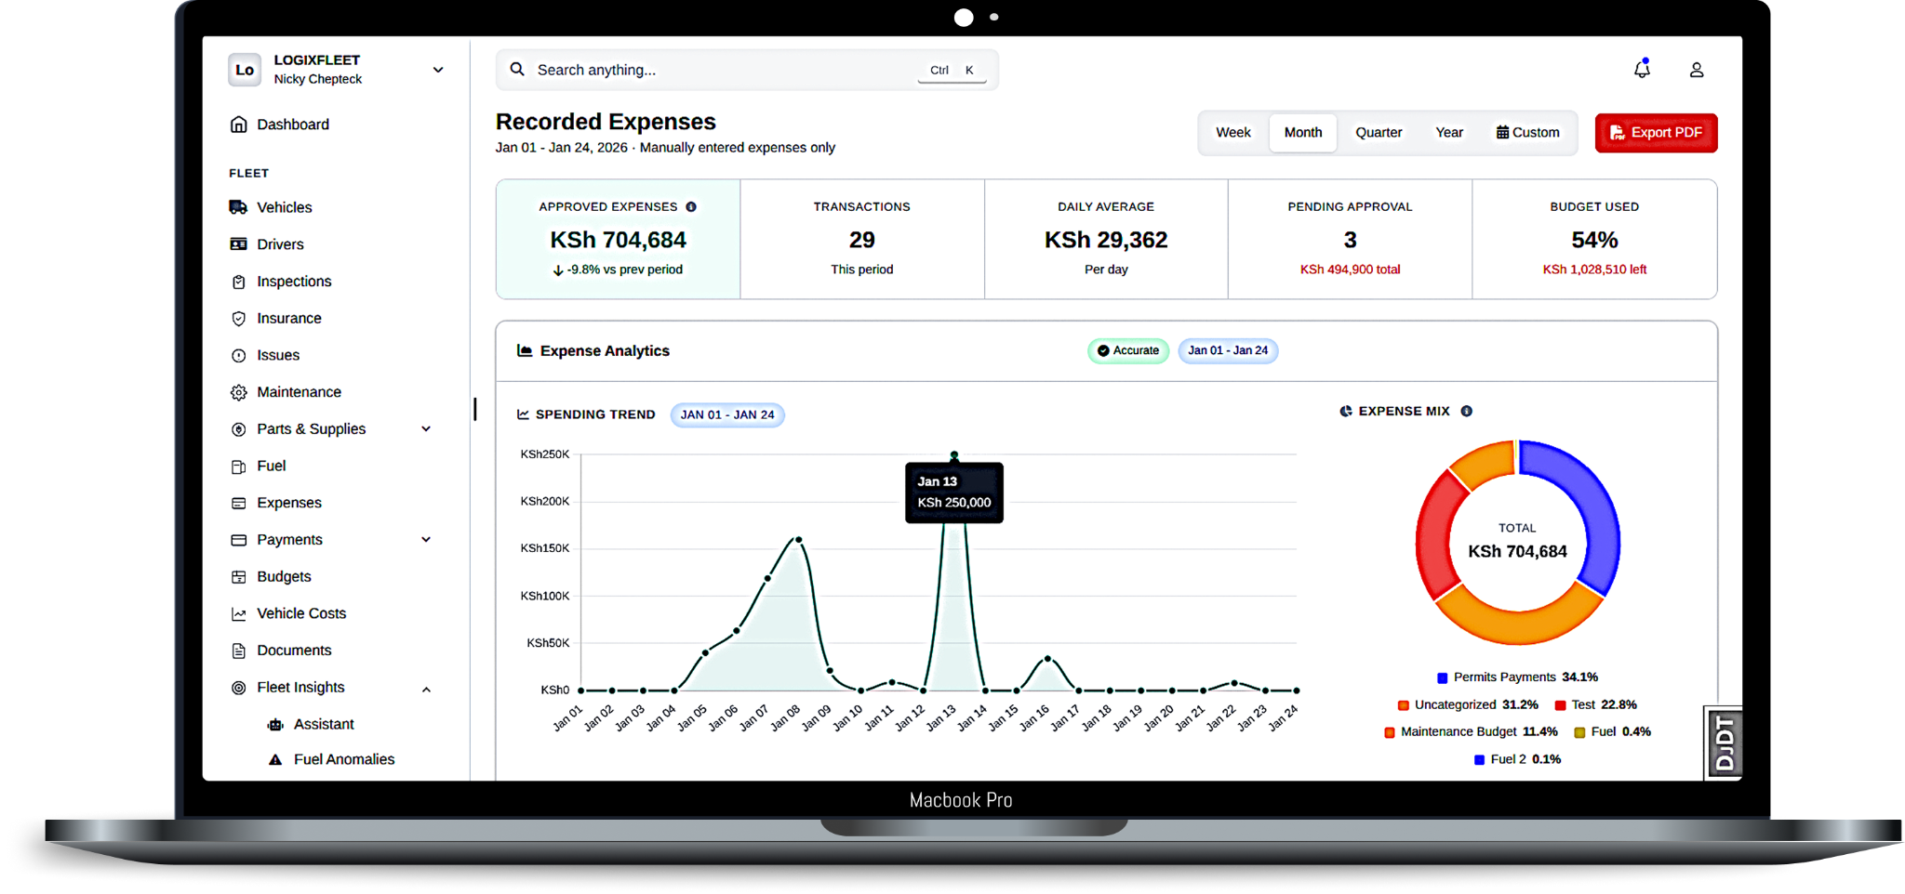

What is Siphyy?
Siphyy brings observability to what breaks and accountability to what's spent, turning fleet guesswork into governed profit.

Slide 3

The Core Insight
You can’t optimize last-mile delivery if your fleet is broken.

Slide 4



Why we Built Siphyy
The Setup
25 Uber cars.
4–5 years of fleet operations. $12k/month revenue. Daily cash flow, monthly P&L.
The Problem
No system of record.
Repair spend swung from 10% to 120% of revenue month-to-month. Untracked parts, duplicate replacements, counterfeit components. One month: $5k in repairs against $12k earnings. I couldn't scale.
The Insight
The problem wasn't bad drivers or broken cars.
It was no data. Repair spend swung from 10% to 120% depending on breakdowns and fraud events. Without audit trails, you can't distinguish fraud from mechanics.

Slide 5

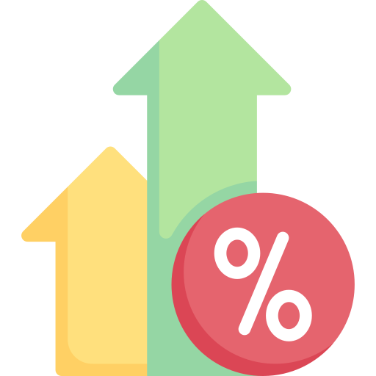




The Problem: FMCG Fleet Operators
Thin margins:
Operating $30–100k/month in fleet revenue, but lose 10–20% monthly to invisible waste (repairs, fraud, duplicates).
No supplier truth:
Can't verify original vs. counterfeit parts. No audit trail.
Tender risk:
Can't bid confidently.
"Will my fleet hold up?" → Hedge with extra vehicles → margin compression.
Duplicate work:
Battery replaced twice in one month. Drivers don't know. No history
Operations on WhatsApp + paper. Procurement approval? Untracked. Fuel siphoning? Undetected.

Slide 6









Why Existing Tools Don't Work
Trackers and Last mile delivery (Leta, Tracksolid Pro, etc.)
Optimize routing and ETA. Don't address root fleet problems: breakdown prevention, fraud detection, cost governance. Solve symptoms, not causes.
Generic ERPs (Odoo, SAP)
Solve everything. Require heavy customization, specialist teams, and months to deploy. Built for global ops, not African fleet ops.

Slide 7
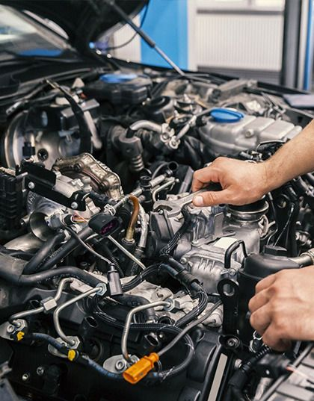
Our Thesis
Purpose-built for FMCG fleets in Africa.
Fix fleet operations at the root layer:
System of record + Governance + Anomaly detection

Slide 8


Market Sizing from Kenya to East Africa Scale
Kenya FMCG Market
Venture-Scale TAM (Multi-Segment + Multi-Region)
80 - 100
FMCG operators
3,500 - 5,000
Vehicles (50+ fleets)
4 - 5x
Multi-segment Kenya potential
$100M+
Pan-Africa opportunity
$27K - $54K
ACV per customer
$2.7M - $4.5M
Total TAM
East Africa: Tanzania + Uganda = $20M+ TAM (24–36 months)
West Africa: Nigeria/Ghana = 5–10x TAM
Year 1: 3 customers × $36K = $108K ARR by Q4
Pricing Model: $1.5K base + $15/vehicle
Serviceable Market (SAM): 20–30
operators = $540K–$1.2M

Slide 9


Why now?
1
3
5
Insurance & compliance pressure
ERP failure in Africa
Fuel price volatility
2
4
Operators can't afford hidden waste. Every liter counts.
Regulators pushing for audit trails on fleet spend and maintenance.
Odoo/SAP customization too slow/expensive. Purpose-built SaaS is winning.
Tender requirements tightening
WhatsApp ubiquity
Logistics companies demanding "proof of fleet uptime" before awarding contracts.
Drivers already on WhatsApp. No new app = fast adoption, zero training cost.

Slide 10
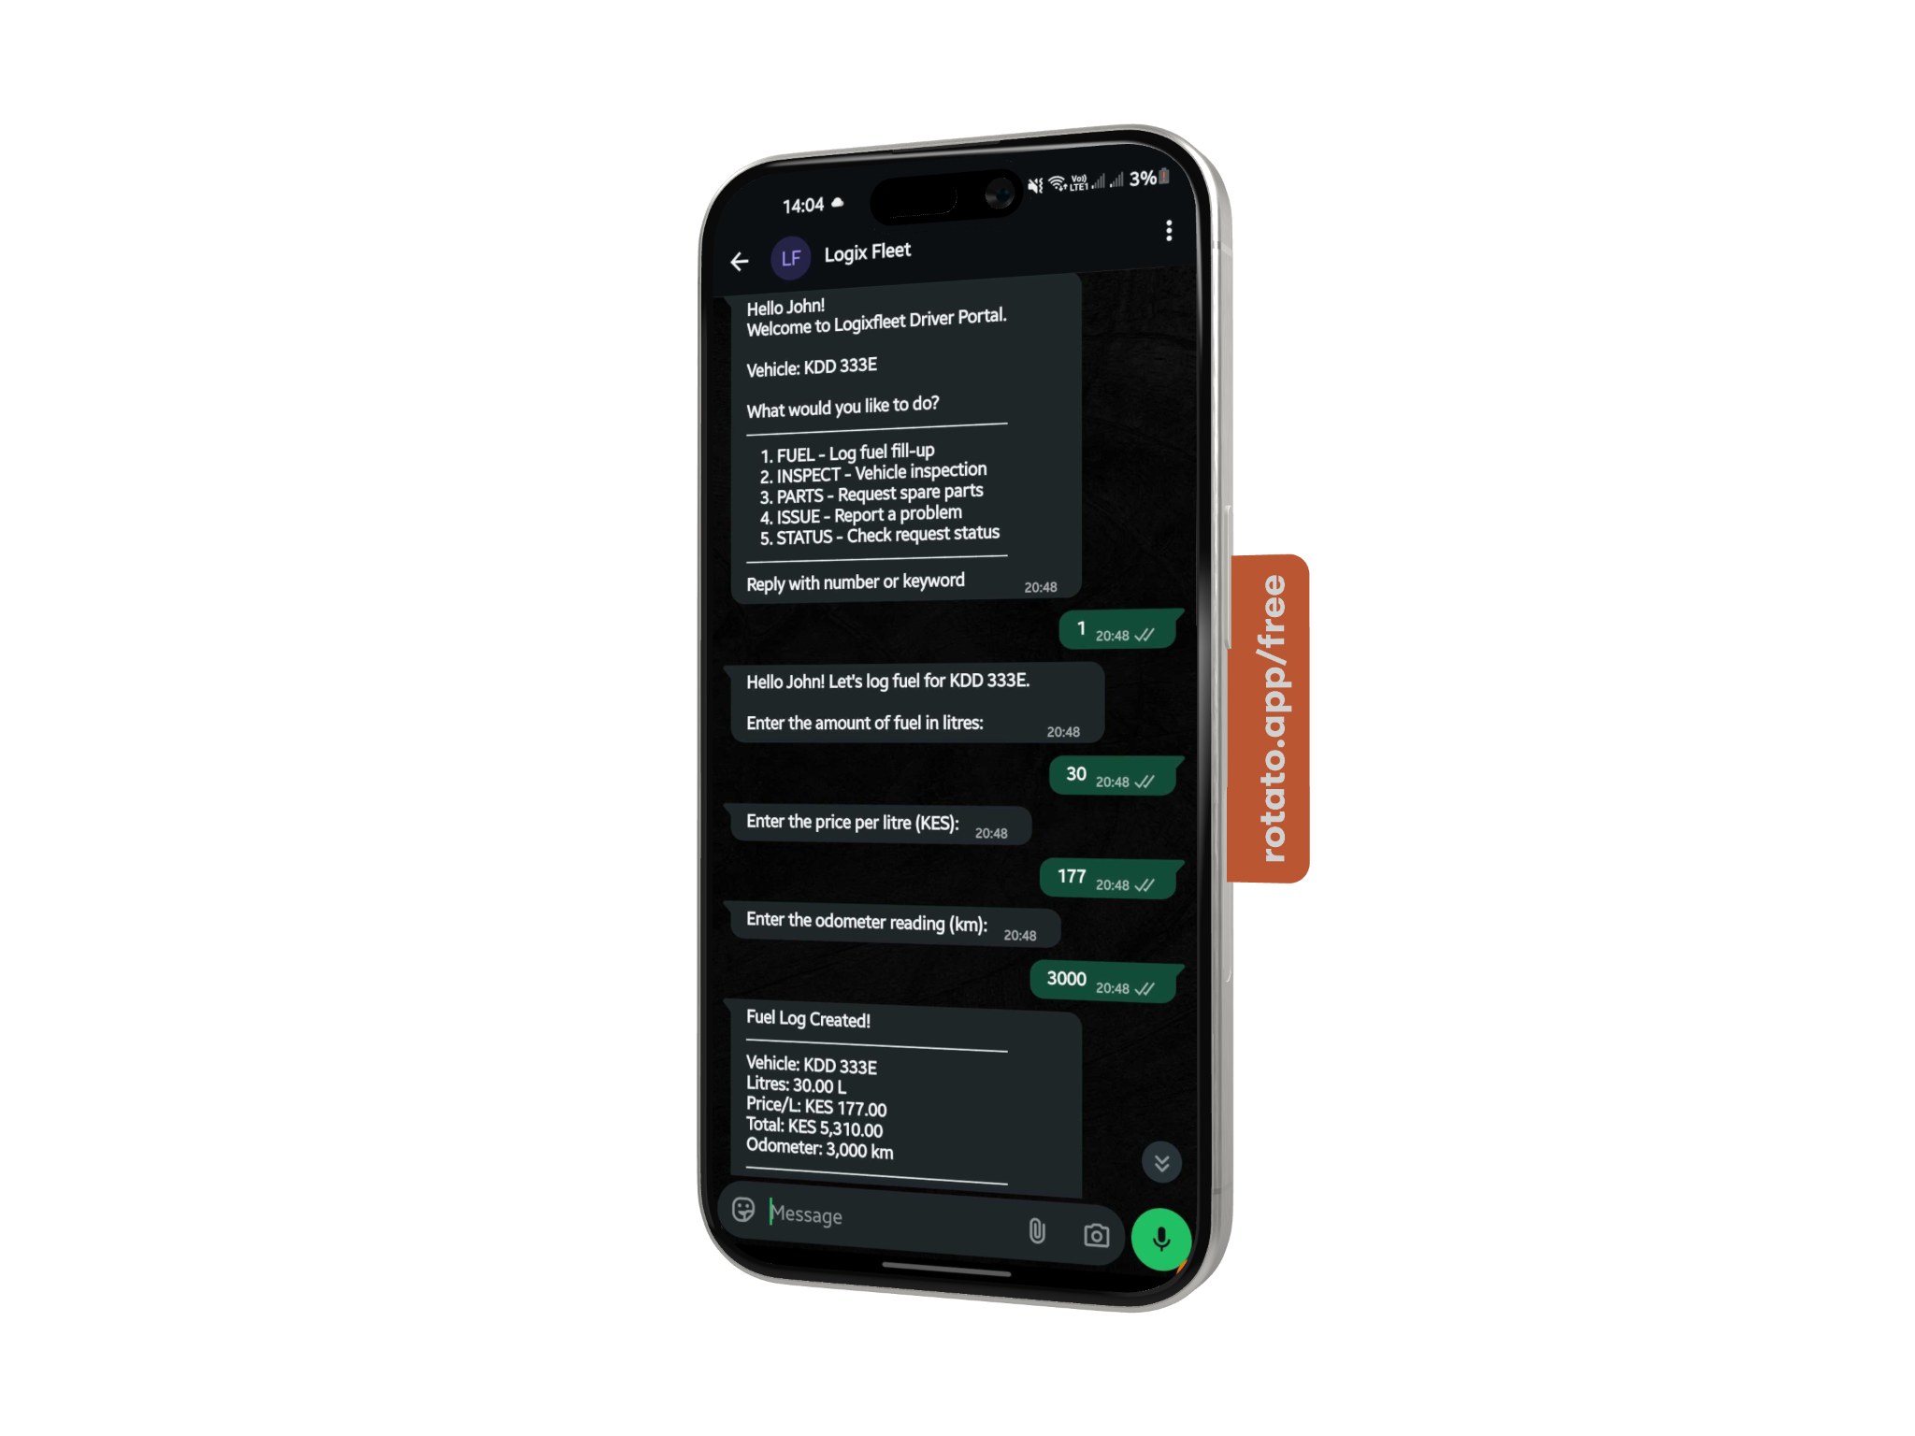
Capture Reality
No new app. Drivers capture reality from the field in minutes via WhatsApp.
Pre-trip inspections: Checklist + photos. Issues auto-created as work orders.
Shift check-ins: Start/end shifts, odometer, notes, all via WhatsApp or web.
Issue reporting: Drivers flag problems instantly. Escalate to ops team.

Slide 11
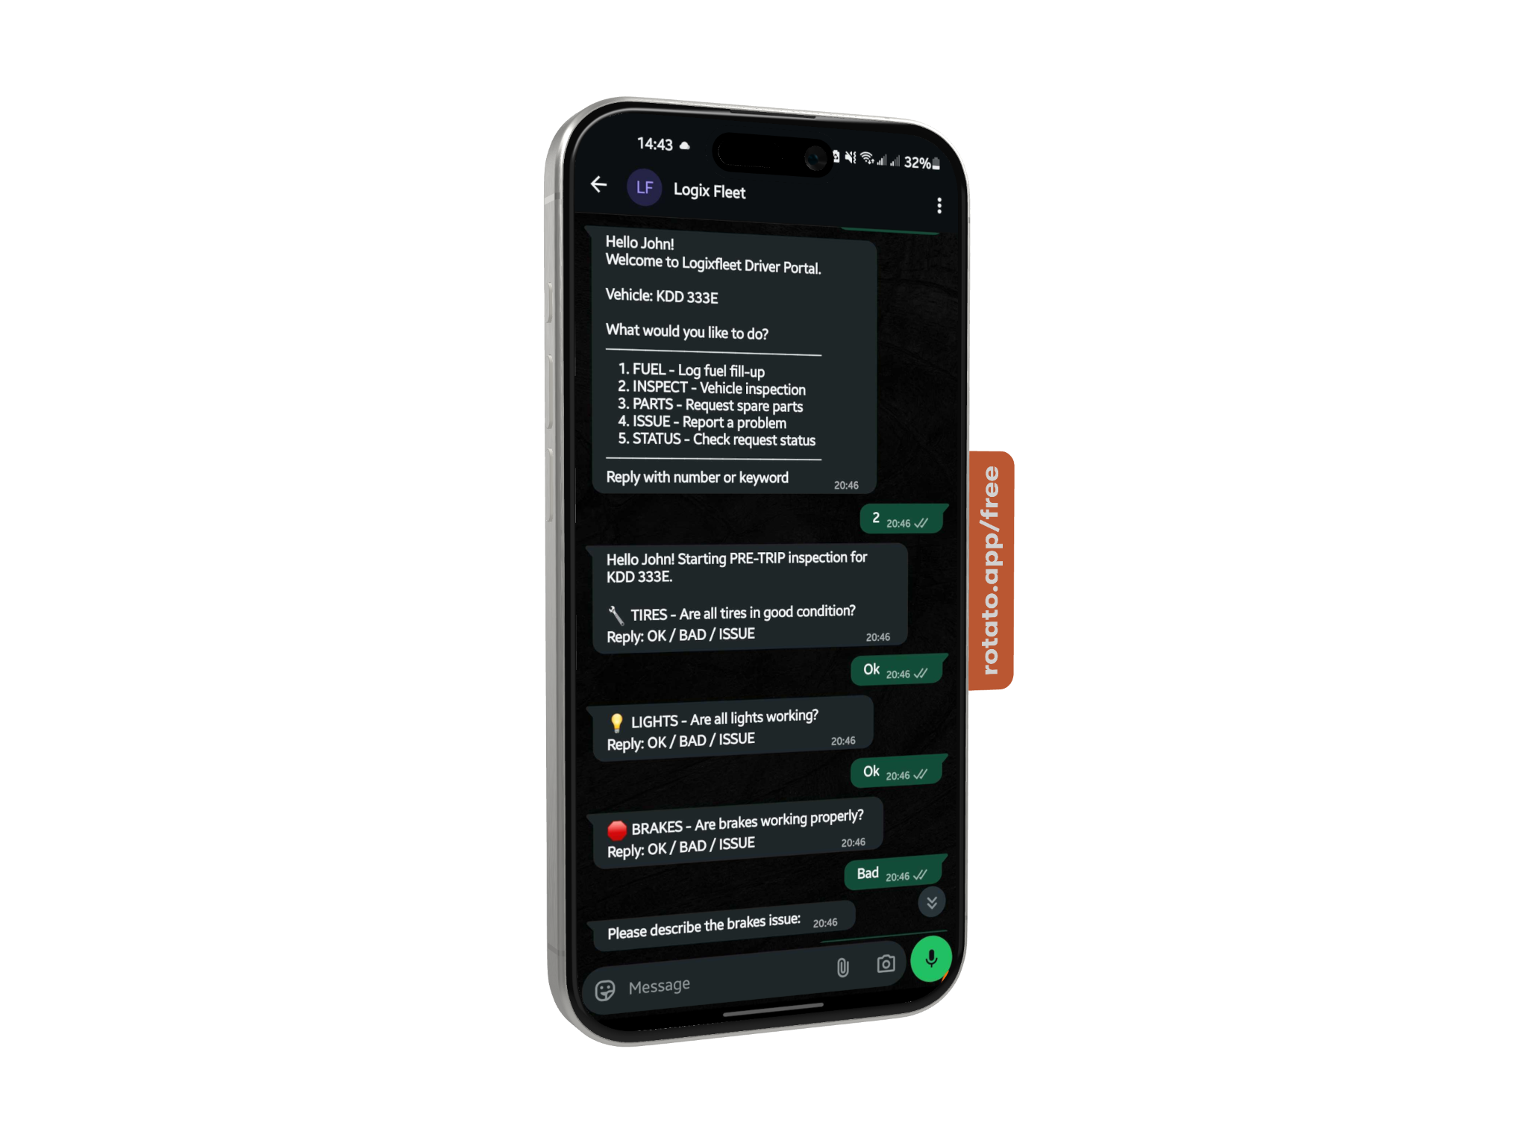
Govern Spend
Stop duplicate repairs and fraudulent spend with auditable approval workflows.
Parts/repair requests: Driver or ops requests via WhatsApp/Web.
Auto-check history: When was this part last replaced? Warranty? Shelf life?
Approve with evidence: Full audit trail. Prevents duplicates, fraud and unnecessary spending.

Slide 12
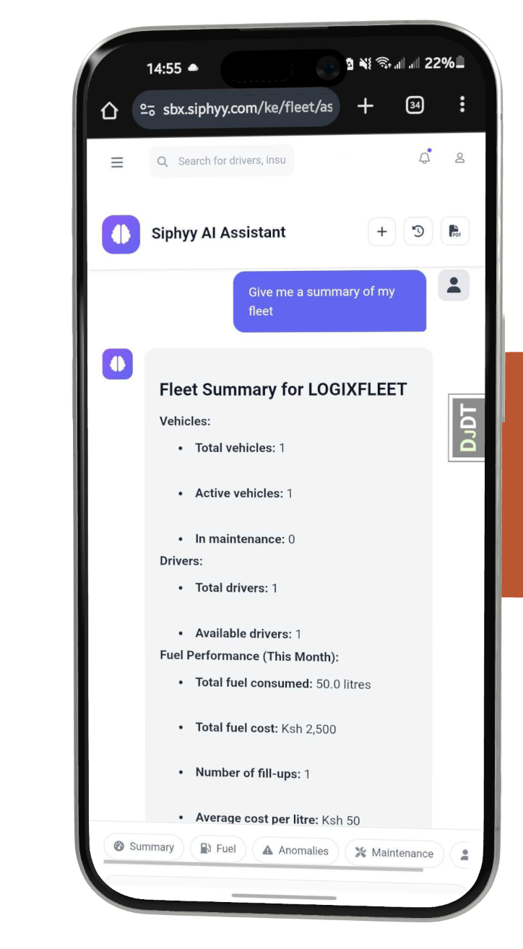
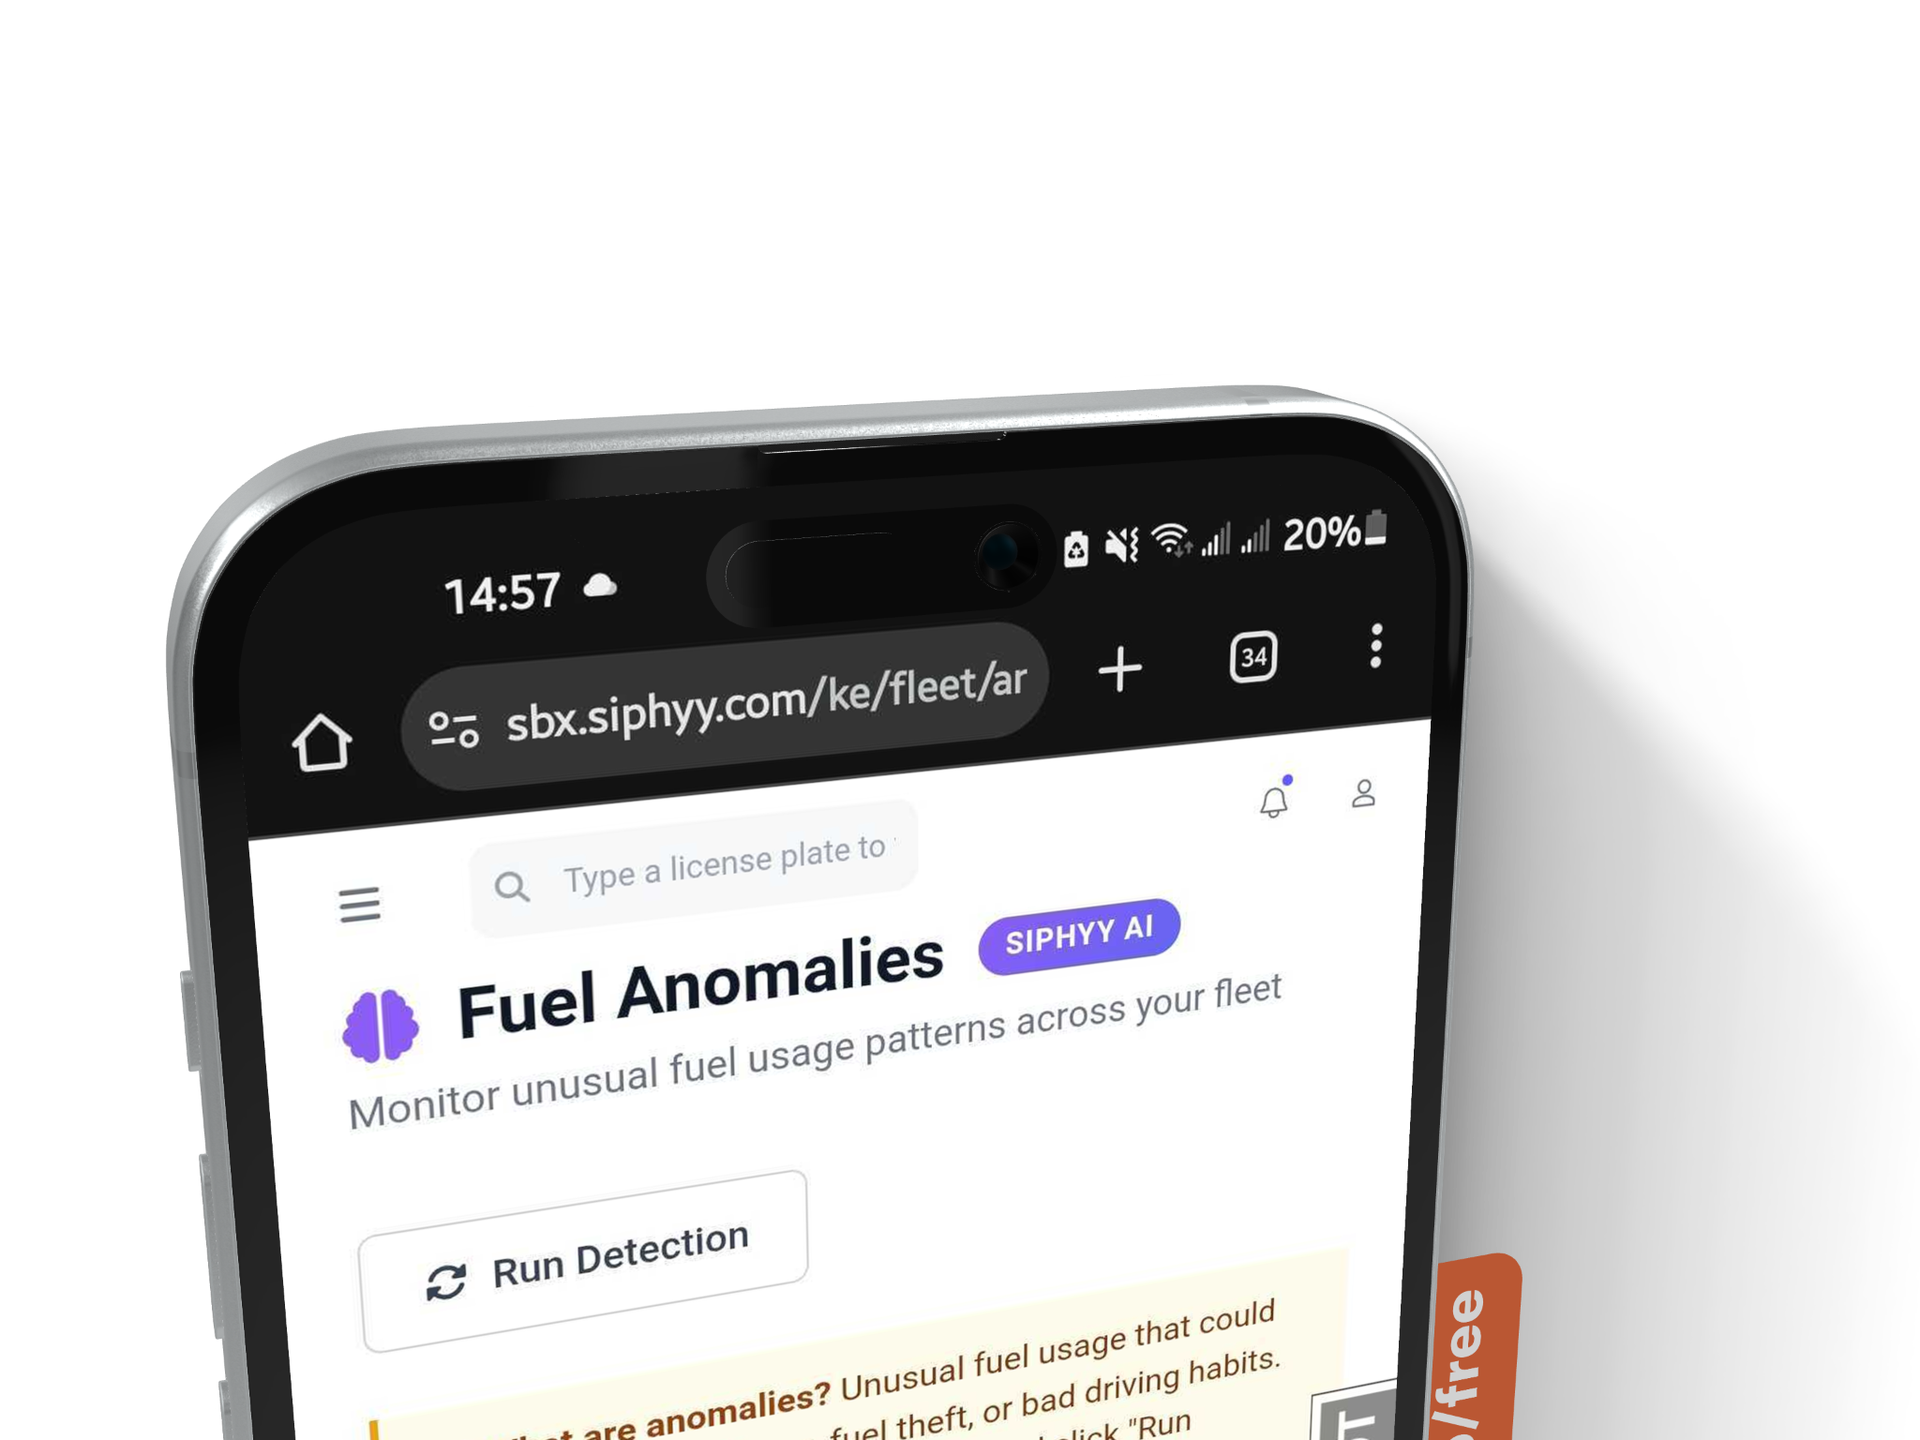
Detect Anomalies & AI
No new app. Drivers capture reality from the field in minutes via WhatsApp.
Fleet AI: Ask your fleet: "What's broken?" "Who's at risk this week?" One question view.
Fuel AI: Anomaly detection. Efficiency drops? Unusual consumption? Flag it. Diagnose: theft vs. mechanical fault vs. bad data.
Carbon tracking: Less fuel used = lower emissions. ESG-ready reporting.

Slide 13
Who We Serve
The FMCG Fleet Operator
50-500 vehicles.
Delivering daily to retailers along Kenya
Operating $30-100k/month in fleet revenue but losing 10-20% monthly to invisible leaks (duplicate repairs, fraud, fuel anomalies)
Their Pain: “I bid for a big tender, but I can’t confidently commit because I don’t know if my fleet will hold up.
So I hire extra vehicles to hedge my risk. But that cuts my margin.

Slide 14




Why Siphyy Wins
vs. Trackers (Leta, Songa, etc.)
Purpose: Routing + ETA optimization.
Siphyy: Fix fleet operations at root layer, maintenance governance, fraud detection, cost control, uptime prediction. Different category entirely.
vs. Generic ERPs (Odoo, SAP, ERPNext)
Build time: 6–12 months customization + specialist teams.
Siphyy: Purpose-built for FMCG fleet ops in Africa. Deploy in weeks. No customization. Workflow pre-baked.
vs. Status Quo (WhatsApp + Spreadsheets)
Today: No audit trails, no system of record, uncontrolled spend, no anomaly detection.
Siphyy: First-mover in FMCG fleet operations SaaS. Clear category win.

Slide 15










Integrations
Siphyy integrates seamlessly with your existing: -
ERP, e-commerce, and accounting systems

Slide 16
Go-To-Market Strategy
Reach 5+ paying customers (~$180k ARR run-rate).
Expand to Tanzania / Uganda.
Build case studies + referral engine
Close 3 FMCG fleet pilots in Kenya.
Prove unit level.
Phase 2
(Months 3-6)
Phase 1
(Months 0-3)
Phase 3
(Months 6-12)
Convert 3 pilots to paying customers
Lock in reputable economics
Direct Sales Model: Founder-led sales in Year 1. Sales hire only after validating conversion + pricing

Slide 17
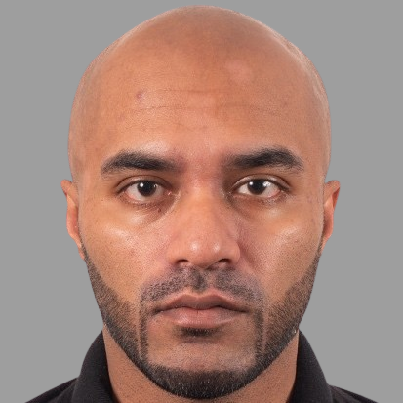
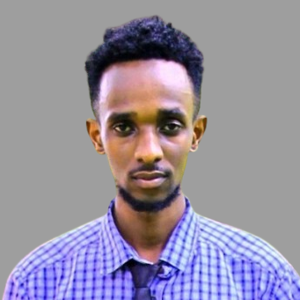

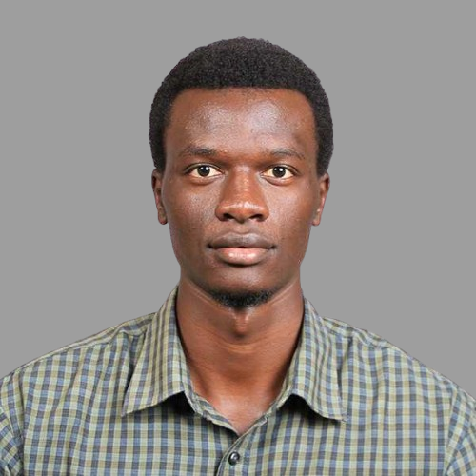

The Team
Surajit Das
Founder
Brian Kiboi
Elvis Kangethe
Nicky Chemos
Mordecai Junior
QA Tester
Full Stack Developer
Backend Developer
Frontend Developer

Slide 18
Pricing and Business Model
Fleet Control OS - Hybrid Pricing Model
$1500 / month platform fee + $15/vehicle/month (all vehicles)
Annual contracts (billed quarterly). Optimized for 50-500 vehicle FMCG fleet operators (our ICP). Pilots credited toward Year 1.
50 vehicles
$2,250/mo
$27k/year ACV
100 vehicles
$3,000/mo
$36k/year ACV
250 vehicles
$5,250/mo
$36k/year ACV

Slide 19
Rationale + Unit Economics
Value Anchor: Trackers solve routing. Siphyy solves cost control (audit trail + governance + anomalies). Not comparable - different category.
ROI payback: 100-vehicle fleet loses $1.5–5k/month to maintenance fraud + duplicate repairs + fuel anomalies (example: duplicate battery + inflated labor + counterfeit part = $800–$2,000 per event). Siphyy at $3k/month becomes ROI-positive by preventing one fraud/duplicate incident or avoiding one major downtime day per month.
Unit econ: Typical customer $36k/year ACV × 80% GM = $28.8k gross profit/year. CAC ~$8k (includes pilot support + travel + founder-led sales) → CAC payback 3–4 months. Year 1 CAC is founder-led; may rise briefly with team hires, then falls with case studies + procurement templates + referrals.
Transparent scaling: Every vehicle adds $15/mo value. No cliff pricing. Revenue grows as customer success grows.

Slide 20
$500k Pre-Seed: Allocation & Year 1 Ramp
Use of Funds (12–15mo runway)
GTM & Sales (45%): $225k — Founder-led sales + 1 sales rep + customer success
Product & Eng (35%): $175k — Founder + 2 engineers (backend, mobile); Q2/Q4 hiring per plan
Ops & Infra (15%): $75k — Cloud hosting, legal, WhatsApp API, compliance tooling
Buffer (5%): $25k — Contingency + travel
Year 1 Sales Path (Realistic, Pilot-Driven)
3 pilots in flight (overlapping): 10–14 week cycle (6–12 week pilot + 4–8 week procurement)
Q2 2026: 1st paid conversion ($36k ACV)
Q3 2026: 2nd paid ($72k ARR run-rate) | Q4 2026: 3rd paid ($108k run-rate) | Q1 2027: 5+ customers (~$180k ARR run-rate)
Unit econ validation: CAC $8k → 3–4 month payback. 80% GM (~$29k/year/customer at $36k ACV)
Post-Year 1 acceleration: Case studies + referrals + procurement templates + multi-segment expansion

Slide 21

Inefficient fleets don't just leak profit, they leak emissions.

Slide 22
Let's Fix the Backbone
Siphyy is building the Fleet Control OS for reliable African logistics.
Join us in solving the root layer.

Slide 23



Contact us
Get in touch and let us know how we can help.
surajit@logixfleet.com

